Slide 1
FSM Example
Ruba Alkhasawneh

Slide 2
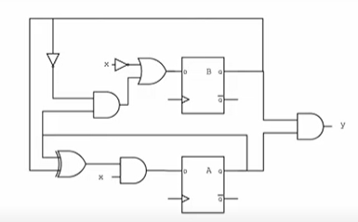
FSM Example
A_{(n+1)} = (A_{(n)} XOR B_{(n)}) . x
B_{(n+1)} = (A_{(n)} . B’_{(n)}) + ~x
Y = A.B

Slide 3
FSM Example
Present State |  | Input | Next State | Next State | Output
A | B | X | A | B | Y
0 | 0 | 0 | 0 | 1 | 0
0 | 0 | 1 | 0 | 0 | 0
0 | 1 | 0 | 0 | 1 | 0
0 | 1 | 1 | 1 | 0 | 0
1 | 0 | 0 | 0 | 1 | 0
1 | 0 | 1 | 1 | 1 | 0
1 | 1 | 0 | 0 | 1 | 1
1 | 1 | 1 | 0 | 0 | 1

Slide 4











FSM Example
Present State |  | Input | Next State | Next State | Output
A | B | X | A | B | Y
0 | 0 | 0 | 0 | 1 | 0
0 | 0 | 1 | 0 | 0 | 0
0 | 1 | 0 | 0 | 1 | 0
0 | 1 | 1 | 1 | 0 | 0
1 | 0 | 0 | 0 | 1 | 0
1 | 0 | 1 | 1 | 1 | 0
1 | 1 | 0 | 0 | 1 | 1
1 | 1 | 1 | 0 | 0 | 1
0
S0/0
S1/0
S3/1
S2/0

